Slide 1
Spiral Model

Slide 2
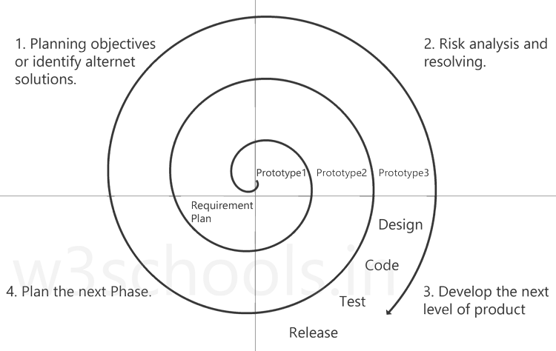

Slide 3
Introduction
The spiral model is a systems development lifecycle (SDLC) method used for Risk management.
Spiral model is META model i.e it has various advantages of others models like waterfall model(step by step),prototype model,iterative model(feedback)etc.

Slide 4
Spiral Model Phases
When looking at a diagram of a spiral model, the radius of the Spiral represents the cost of the project and the Angular Dimensions represents the progress made in the current phase.
Every phase can be broken into four quadrants: identifying and understanding requirements, performing risk analysis, building the prototype and evaluation of the software's performance.

Slide 5
1 .Identify Objectives
Phases begin in the quadrant dedicated to the identification and understanding of requirements.
It is important to also identify alternative solutions in case the attempted version fails to perform.

Slide 6
2. Perform Risk Analysis
This is the important phase in spiral model.
In this phase possible risks are find and the solution is made to resolve the risks.
Prototype is made before going to software and all the risks are tested on prototype.

Slide 7
3. develop the next version of product
The prototype is built and tested.
This step includes: architectural design, design of modules, physical product design and the final design.
Refined and changes are done by seeing customers requirements.

Slide 8
4.review and plan for next phase
Finally, in the fourth quadrant, the test results of the newest version are evaluated.
After showing the project to customer and feedback is taken; whatever changes are required from customer are done by again repeating the spiral model again and again until the customer is satisfied.

Slide 9
Uses of Spiral Model
projects in which frequent releases are necessary
projects in which changes may be required at any time
long term projects that are not feasible due to altered economic priorities
medium to high risk projects
projects in which cost and risk analysis is important
projects that would benefit from the creation of a prototype
projects with unclear or complex requirements.

Slide 10
Benefits of Spiral Model
Flexibility - Changes made to the requirements after development has started can be easily adopted and incorporated.
Risk handling - The spiral model involves risk analysis and handling in every phase, improving security and the chances of avoiding attacks and breakages. The iterative development process also facilitates risk management.
Customer satisfaction - The spiral model facilitates customer feedback. If the software is being designed for a customer, then the customer will be able to see and evaluate their product in every phase. This allows them to voice dissatisfactions or make changes before the product is fully built, saving the development team time and money.

Slide 11
Limitations
High cost - The spiral model is expensive and, therefore, is not suitable for small projects.
Dependence on risk analysis - Since successful completion of the project depends on effective risk handling, then it is necessary for involved personnel to have expertise in risk assessment.
Complexity - The spiral model is more complex than other SDLC options. For it to operate efficiently, protocols must be followed closely. Furthermore, there is increased documentation since the model involves intermediate phases.
Hard to manage time - Going into the project, the number of required phases is often unknown, making time management almost impossible. Therefore, there is always a risk for falling behind schedule or going over budget.

